Slide 1
Data Structures and Algorithms (ESO207)
Lecture 39
Integer sorting
Counting Sort and Radix Sort
Radix Sort

Slide 2
Integer sorting

Slide 3

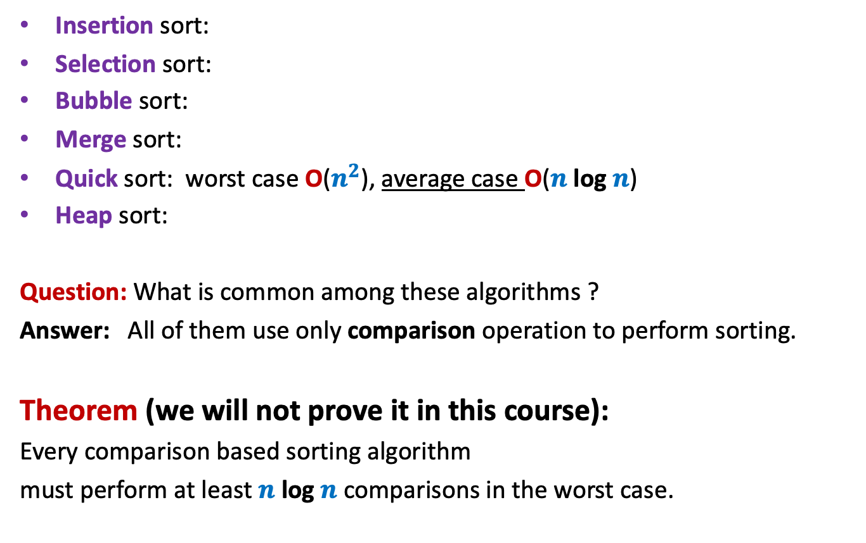





Algorithms for Sorting $n$ elements
Insertion sort:
Selection sort:
Bubble sort:
Merge sort:
Quick sort: worst case O($n^{2}$), average case O($n$ log $n$)
Heap sort:
Question: What is common among these algorithms ?
Answer: All of them use only comparison operation to perform sorting.
Theorem (we will not prove it in this course):
Every comparison based sorting algorithm
must perform at least $n$ log $n$ comparisons in the worst case.
O($n^{2}$)
O($n^{2}$)
O($n^{2}$)
O($n$ log $n$)
O($n$ log $n$)

Slide 4

Question: Can we sort in O($n$) time ?
The answer depends upon
the model of computation.
the domain of input.

Slide 5
Integer sorting

Slide 6

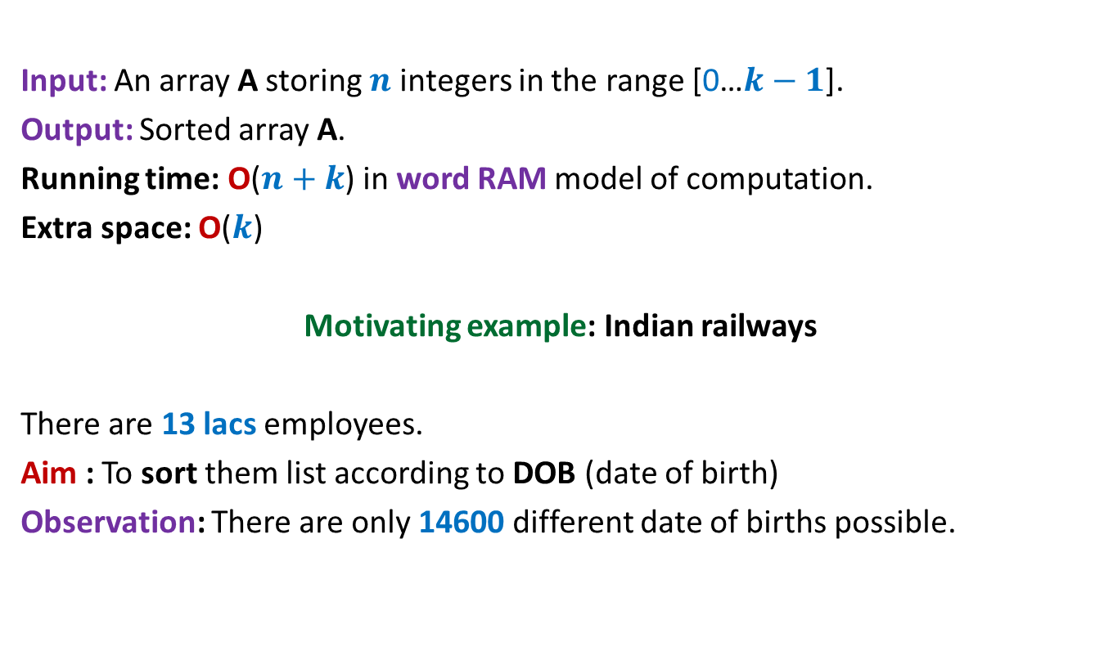
Counting sort: algorithm for sorting integers
Input: An array A storing $n$ integers in the range [0…$k−1$].
Output: Sorted array A.
Running time: O($n+k$) in word RAM model of computation.
Extra space: O($k$)
Motivating example: Indian railways
There are 13 lacs employees.
Aim : To sort them list according to DOB (date of birth)
Observation: There are only 14600 different date of births possible.
$k$= O($n$)

Slide 7
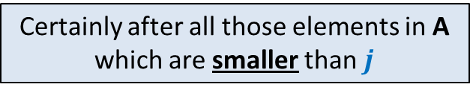

Counting sort: algorithm for sorting integers
0 1 2 3 4 5 6 7
If A[$i$]=$j$,
where should A[$i$] be placed in B ?
A
2 5 3 0 2 3 0 3
0 1 2 3 4 5
Count
2
0
2
3
0
1
Certainly after all those elements in A which are smaller than $j$
0 1 2 3 4 5
Place
2 2 4 7 7 8
0 1 2 3 4 5 6 7
B
3
Final sorted output

Slide 8
Counting sort: algorithm for sorting integers
0 1 2 3 4 5 6 7
A
2 5 3 0 2 3 0 3
0 1 2 3 4 5
Count
2
0
2
3
0
1
0 1 2 3 4 5
Place
2 2 4 6 7 8
0 1 2 3 4 5 6 7
B
0
3

Slide 9
Counting sort: algorithm for sorting integers
0 1 2 3 4 5 6 7
A
2 5 3 0 2 3 0 3
0 1 2 3 4 5
Count
2
0
2
3
0
1
0 1 2 3 4 5
Place
1 2 4 6 7 8
0 1 2 3 4 5 6 7
B
0
3
3

Slide 10
Types of sorting algorithms
In Place Sorting algorithm:
A sorting algorithm which uses only O(1) extra space to sort.
Example: Heap sort, Quick sort.
Stable Sorting algorithm:
A sorting algorithm which preserves the relative order of equal keys while sorting.
Example: Merge sort.
0 1 2 3 4 5 6 7
A
2 5 3 0 6.1 3 7.9 4
0 1 2 3 4 5 6 7
A
0 2 3 3 4 5 6.1 7.9

Slide 11
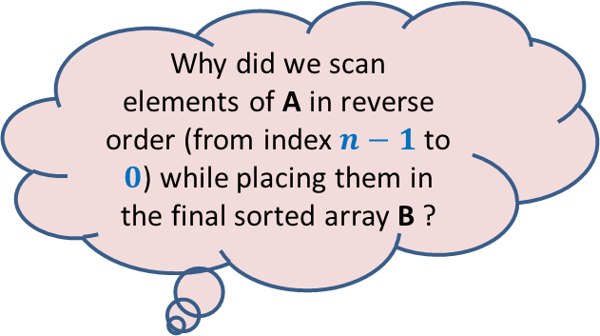
Counting sort: a visual description
0 1 2 3 4 5 6 7
A
2 5 3 0 2 3 0 3
Why did we scan
elements of A in reverse order (from index $n−1$ to $0$) while placing them in the final sorted array B ?
We could have used Count array only to output the elements of A in sorted order. Why did we compute Place and B ?
0 1 2 3 4 5
Count
2
0
2
3
0
1
0 1 2 3 4 5
Place
2 2 4 7 7 8
1
6
Answer:
The input might be an array of records and
the aim to sort these records according
to some integer field.
Answer:
To ensure that Counting sort is stable.
The reason why stability is required will
become clear soon ☺
0 1 2 3 4 5 6 7
B
0
3
3

Slide 12

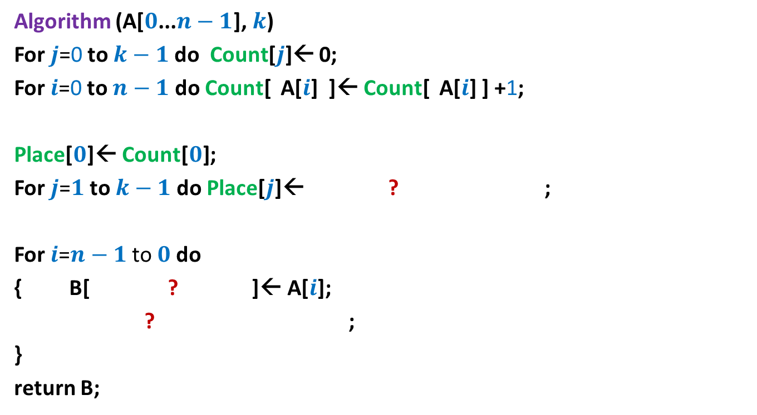



Counting sort: algorithm for sorting integers
Algorithm (A[$0$...$n−1$], $k$)
For $j$=0 to $k−1$ do Count[$j$]← 0;
For $i$=0 to $n−1$ do Count[ A[$i$] ]← Count[ A[$i$] ] +1;
Place[$0$]← Count[$0$];
For $j$=$1$ to $k−1$ do Place[$j$]← ? ;
For $i$=$n−1$ to $0$do
{ B[ ? ]← A[$i$];
? ;
}
return B;
Place[$j−1$] + Count[$j$]
Place[A[$i$]]$−$1
Place[A[$i$]] ← Place[A[$i$]]$−$1;
Each arithmetic operations
involves ? bits
O(log $n$ + log $k$)

Slide 13
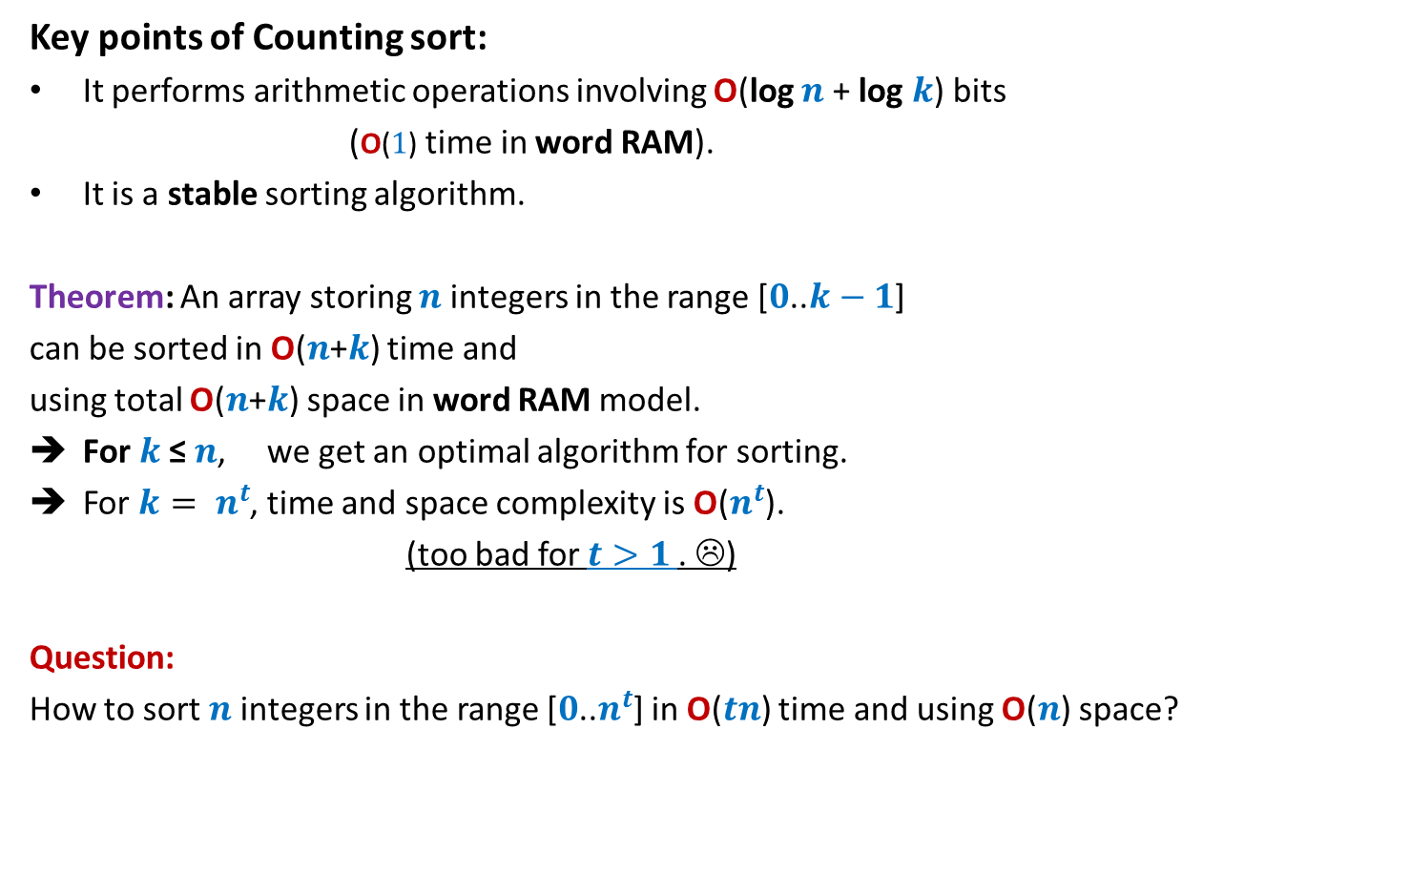
Counting sort: algorithm for sorting integers
Key points of Counting sort:
It performs arithmetic operations involving O(log $n$ + log $k$) bits
(O($1$) time in word RAM).
It is a stable sorting algorithm.
Theorem: An array storing $n$integers in the range [$0$..$k−1$]
can be sorted in O($n$+$k$) time and
using total O($n$+$k$) space in word RAM model.
For $k$≤ $n$, we get an optimal algorithm for sorting.
For $k= n^{t}$, time and space complexity is O($n^{t}$).
(too bad for $t>1$. ☹)
Question:
How to sort $n$integers in the range [$0$..$n^{t}$] in O($tn$) time and using O($n$) space?

Slide 14
Radix Sort

Slide 15





Digits of an integer
$$507266$$
No. of digits = ?
value of digit = ?
$$1011000101011111$$
No. of digits = $16$
value of digit $∈\{0,1\}$
It is up to us how we define digit ?
$$6$$
$$∈\{0,…,9\}$$
$$4$$
$$∈\{0,…,15\}$$

Slide 16
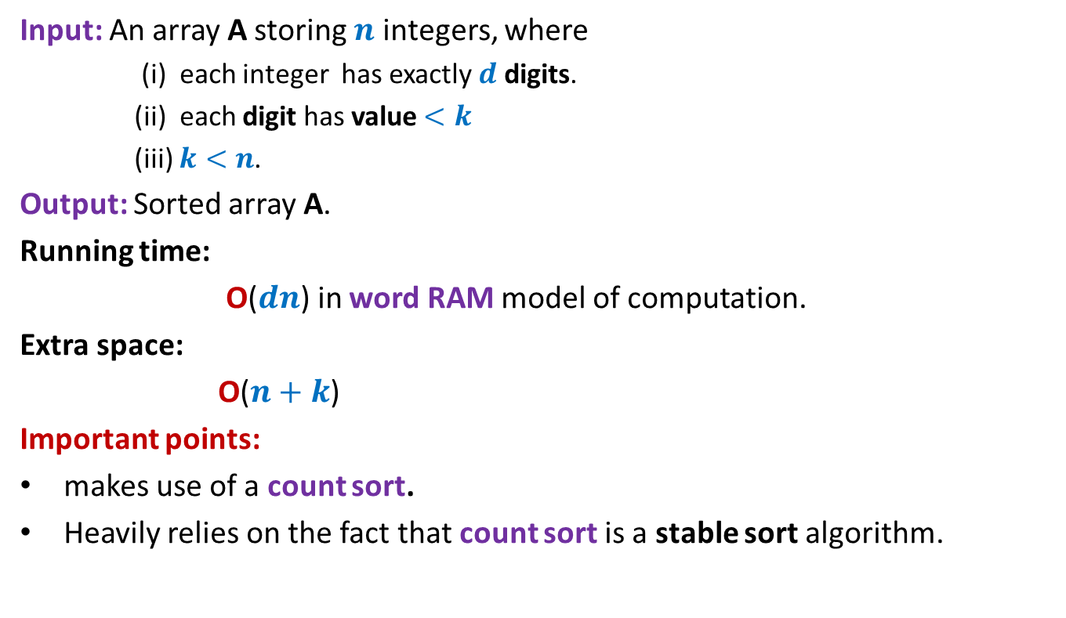
Radix Sort
Input: An array A storing $n$ integers, where
(i) each integer has exactly $d$ digits.
(ii) each digit has value $<k$
(iii) $k<n$.
Output: Sorted array A.
Running time:
O($dn$) in word RAM model of computation.
Extra space:
O($n+k$)
Important points:
makes use of a count sort.
Heavily relies on the fact that count sort is a stable sort algorithm.

Slide 17
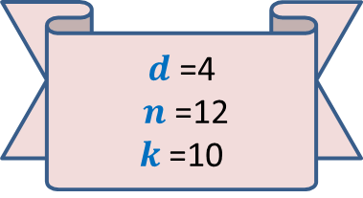
Demonstration of Radix Sort through example
A
2 0 1 2
1 3 8 5
4 9 6 1
5 8 1 0
2 3 7 3
6 2 3 9
9 6 2 4
8 2 9 9
3 4 6 5
7 0 9 8
5 5 0 1
9 2 5 8
5 8 1 0
4 9 6 1
5 5 0 1
2 0 1 2
2 3 7 3
9 6 2 4
1 3 8 5
3 4 6 5
7 0 9 8
9 2 5 8
6 2 3 9
8 2 9 9
$d$=4
$n$=12
$k$=10

Slide 18
Demonstration of Radix Sort through example
A
2 0 1 2
1 3 8 5
4 9 6 1
5 8 1 0
2 3 7 3
6 2 3 9
9 6 2 4
8 2 9 9
3 4 6 5
7 0 9 8
5 5 0 1
9 2 5 8
5 8 1 0
4 9 6 1
5 5 0 1
2 0 1 2
2 3 7 3
9 6 2 4
1 3 8 5
3 4 6 5
7 0 9 8
9 2 5 8
6 2 3 9
8 2 9 9
5 5 0 1
5 8 1 0
2 0 1 2
9 6 2 4
6 2 3 9
9 2 5 8
4 9 6 1
3 4 6 5
2 3 7 3
1 3 8 5
7 0 9 8
8 2 9 9

Slide 19
Demonstration of Radix Sort through example
A
2 0 1 2
1 3 8 5
4 9 6 1
5 8 1 0
2 3 7 3
6 2 3 9
9 6 2 4
8 2 9 9
3 4 6 5
7 0 9 8
5 5 0 1
9 2 5 8
5 8 1 0
4 9 6 1
5 5 0 1
2 0 1 2
2 3 7 3
9 6 2 4
1 3 8 5
3 4 6 5
7 0 9 8
9 2 5 8
6 2 3 9
8 2 9 9
5 5 0 1
5 8 1 0
2 0 1 2
9 6 2 4
6 2 3 9
9 2 5 8
4 9 6 1
3 4 6 5
2 3 7 3
1 3 8 5
7 0 9 8
8 2 9 9
2 0 1 2
7 0 9 8
6 2 3 9
9 2 5 8 8 2 9 9
2 3 7 3
1 3 8 5
3 4 6 5
5 5 0 1
9 6 2 4
5 8 1 0
4 9 6 1

Slide 20
Demonstration of Radix Sort through example
A
2 0 1 2
1 3 8 5
4 9 6 1
5 8 1 0
2 3 7 3
6 2 3 9
9 6 2 4
8 2 9 9
3 4 6 5
7 0 9 8
5 5 0 1
9 2 5 8
5 8 1 0
4 9 6 1
5 5 0 1
2 0 1 2
2 3 7 3
9 6 2 4
1 3 8 5
3 4 6 5
7 0 9 8
9 2 5 8
6 2 3 9
8 2 9 9
5 5 0 1
5 8 1 0
2 0 1 2
9 6 2 4
6 2 3 9
9 2 5 8
4 9 6 1
3 4 6 5
2 3 7 3
1 3 8 5
7 0 9 8
8 2 9 9
2 0 1 2
7 0 9 8
6 2 3 9
9 2 5 8 8 2 9 9
2 3 7 3
1 3 8 5
3 4 6 5
5 5 0 1
9 6 2 4
5 8 1 0
4 9 6 1
1 3 8 5
2 0 1 2
2 3 7 3
3 4 6 5
4 9 6 1
5 5 0 1
5 8 1 0
6 2 3 9
7 0 9 8
8 2 9 9
9 2 5 8 9 6 2 4
Can you see where we are exploiting the fact that Countsort is a stable sorting algorithm ?

Slide 21






Radix Sort
RadixSort(A[$0$...$n−1$], $d\text{,} k$)
{ For $j$=1 to $d$ do
Execute CountSort(A,$k$) …
return A;
}
Correctness:
Inductive assertion:
At the end of $j$th iteration, …
with $j$th digit as the key;
$d$ … $2 1$
$$j$$
A number stored in A ➔
$$j$$
array A is sorted according to the last $j$ digits.
During the induction step, you will have to use the fact that Countsort is a stable sorting algorithm.

Slide 22





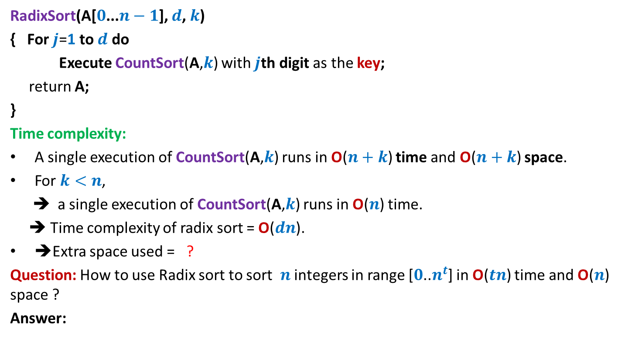


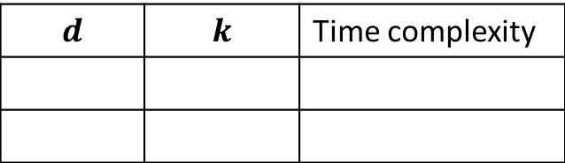



Radix Sort
RadixSort(A[$0$...$n−1$], $d\text{,} k$)
{ For $j$=1 to $d$ do
Execute CountSort(A,$k$) with $j$th digit as the key;
return A;
}
Time complexity:
A single execution of CountSort(A,$k$) runs in O($n+k$) time and O($n+k$) space.
For $k<n$,
➔ a single execution of CountSort(A,$k$) runs in O($n$) time.
➔ Time complexity of radix sort = O($dn$).
➔Extra space used = ?
Question: How to use Radix sort to sort $n$ integers in range [$0$..$n^{t}$] in O($tn$) time and O($n$) space ?
Answer:
O($n$)
$$d$$ | $$k$$ | Time complexity
What digit to use ?
RadixSort(A[$0$...$n−1$], $t\text{,} n$)
$1$ bit
$t$ log $n$
$$2$$
O($tn \text{lo}\text{g} n$)
$\text{lo}\text{g} n$ bits
$$t$$
$$n$$
O($tn$)

Slide 23
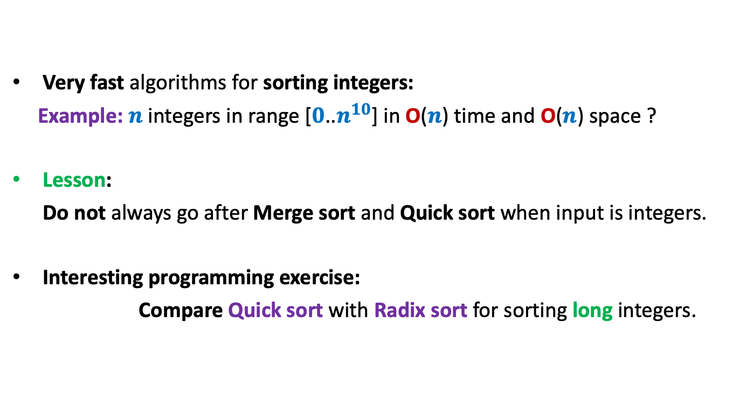
Power of the word RAM model
Very fast algorithms for sorting integers:
Example: $n$ integers in range [$0$..$n^{10}$] in O($n$) time and O($n$) space ?
Lesson:
Do not always go after Merge sort and Quick sort when input is integers.
Interesting programming exercise:
Compare Quick sort with Radix sort for sorting long integers.

